Slide 1
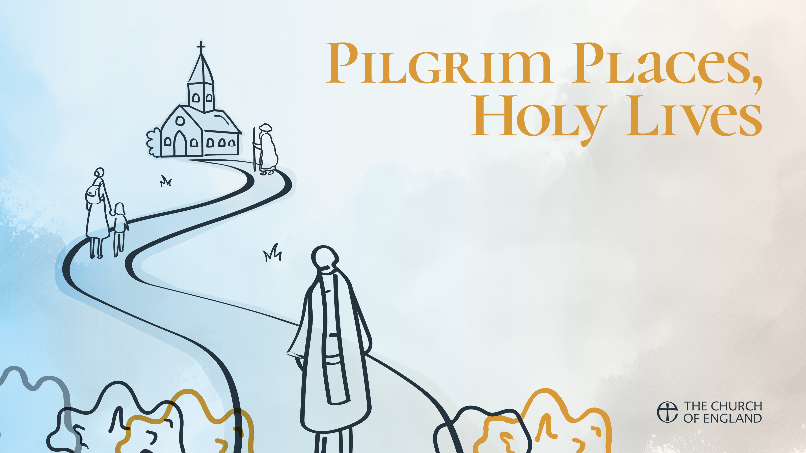
Week 2: St Frideswide and St Etheldreda
Trusting in fear, while waiting, and in the everyday
Remaining joyful and thankful
Reading: Luke 8.22-25

Slide 2
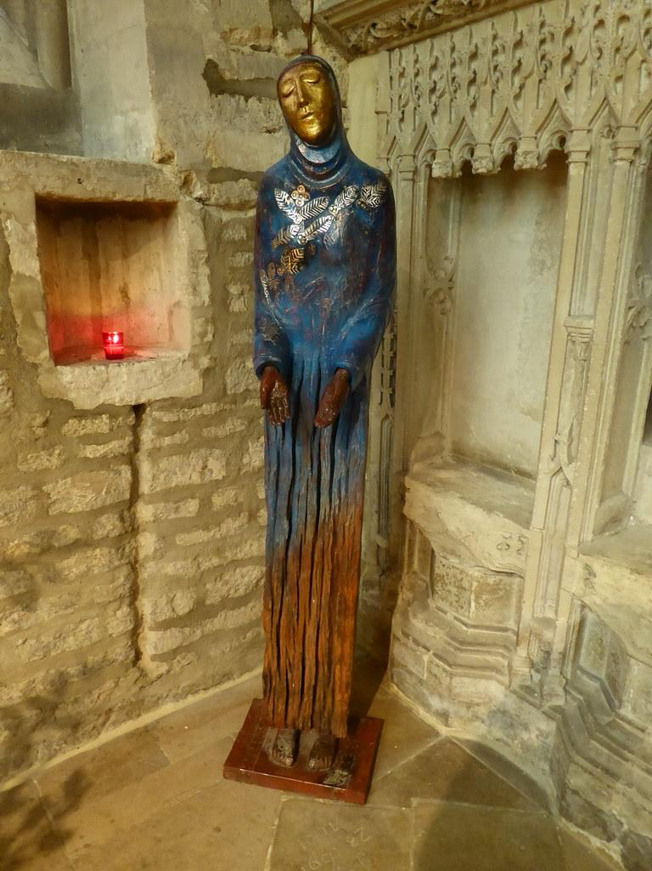
St Frideswide
Patron Saint of Oxford
Christ Church was originally the church of St Frideswide Priory
Presumed to be the place where she founded a nunnery
8th century, contemporary of Bede, died 727
Saxon princess
Old English Frithswith (peace – strong)
Knew she was called to be a nun, and to celibacy.

Slide 3
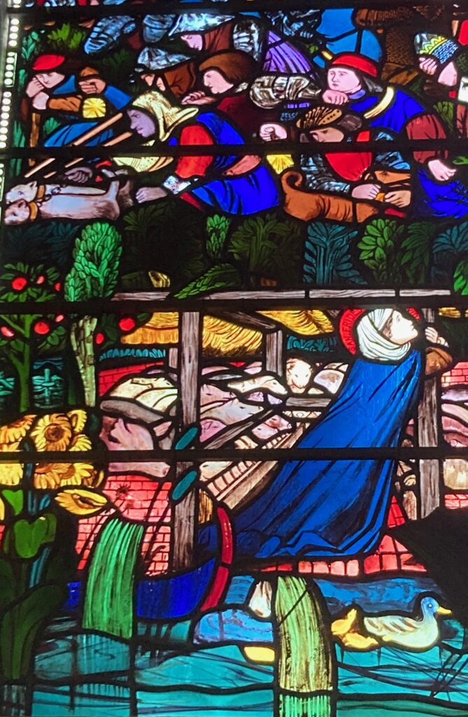
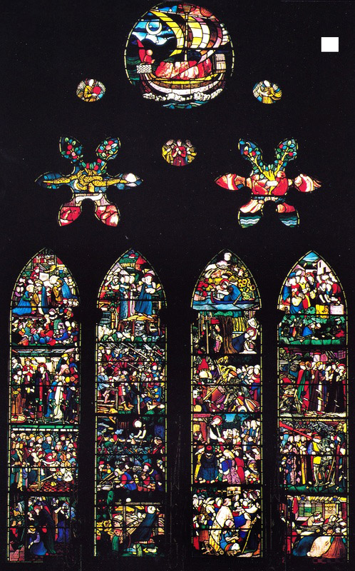
St Frideswide – flight
Pursued by King Algar, despite her vow of celibacy
Forced to flee, first to Abingdon, pursued by king and soldiers
Took refuge in a pigsty
Then fled to a monastery in Binsey

Slide 4
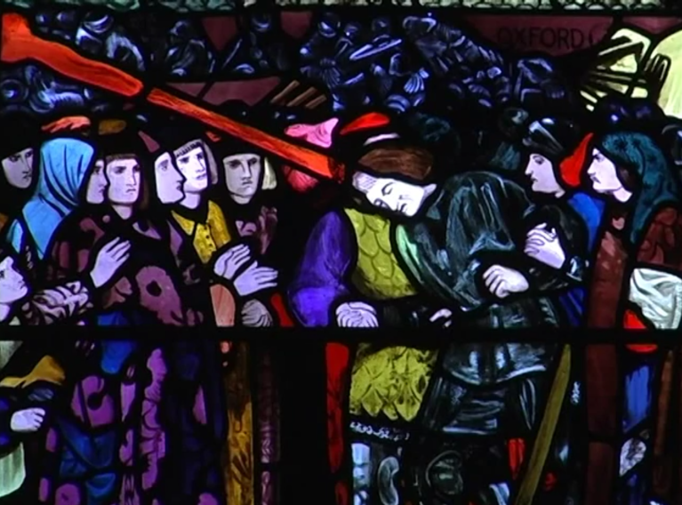
St Frideswide – the healer
God struck King Algar blind
He asked for Frideswide’s forgiveness
She prayed to St Margaret at Binsey, and a spring appeared
She used the water to cure his blindness
The beginning of her reputation as a healer

Slide 5
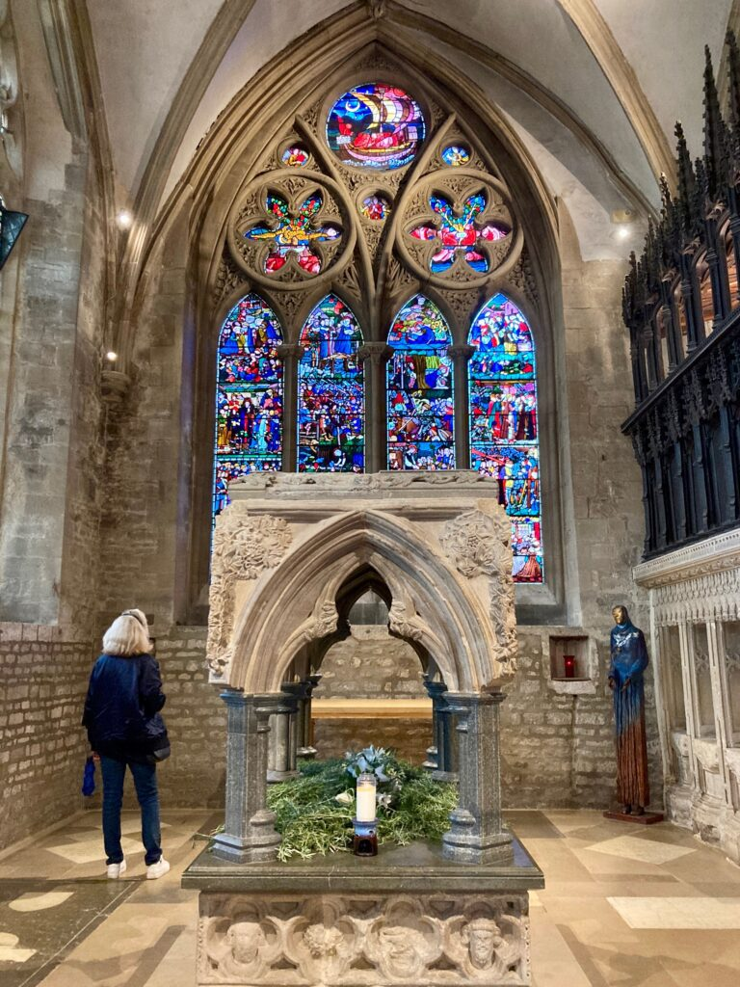
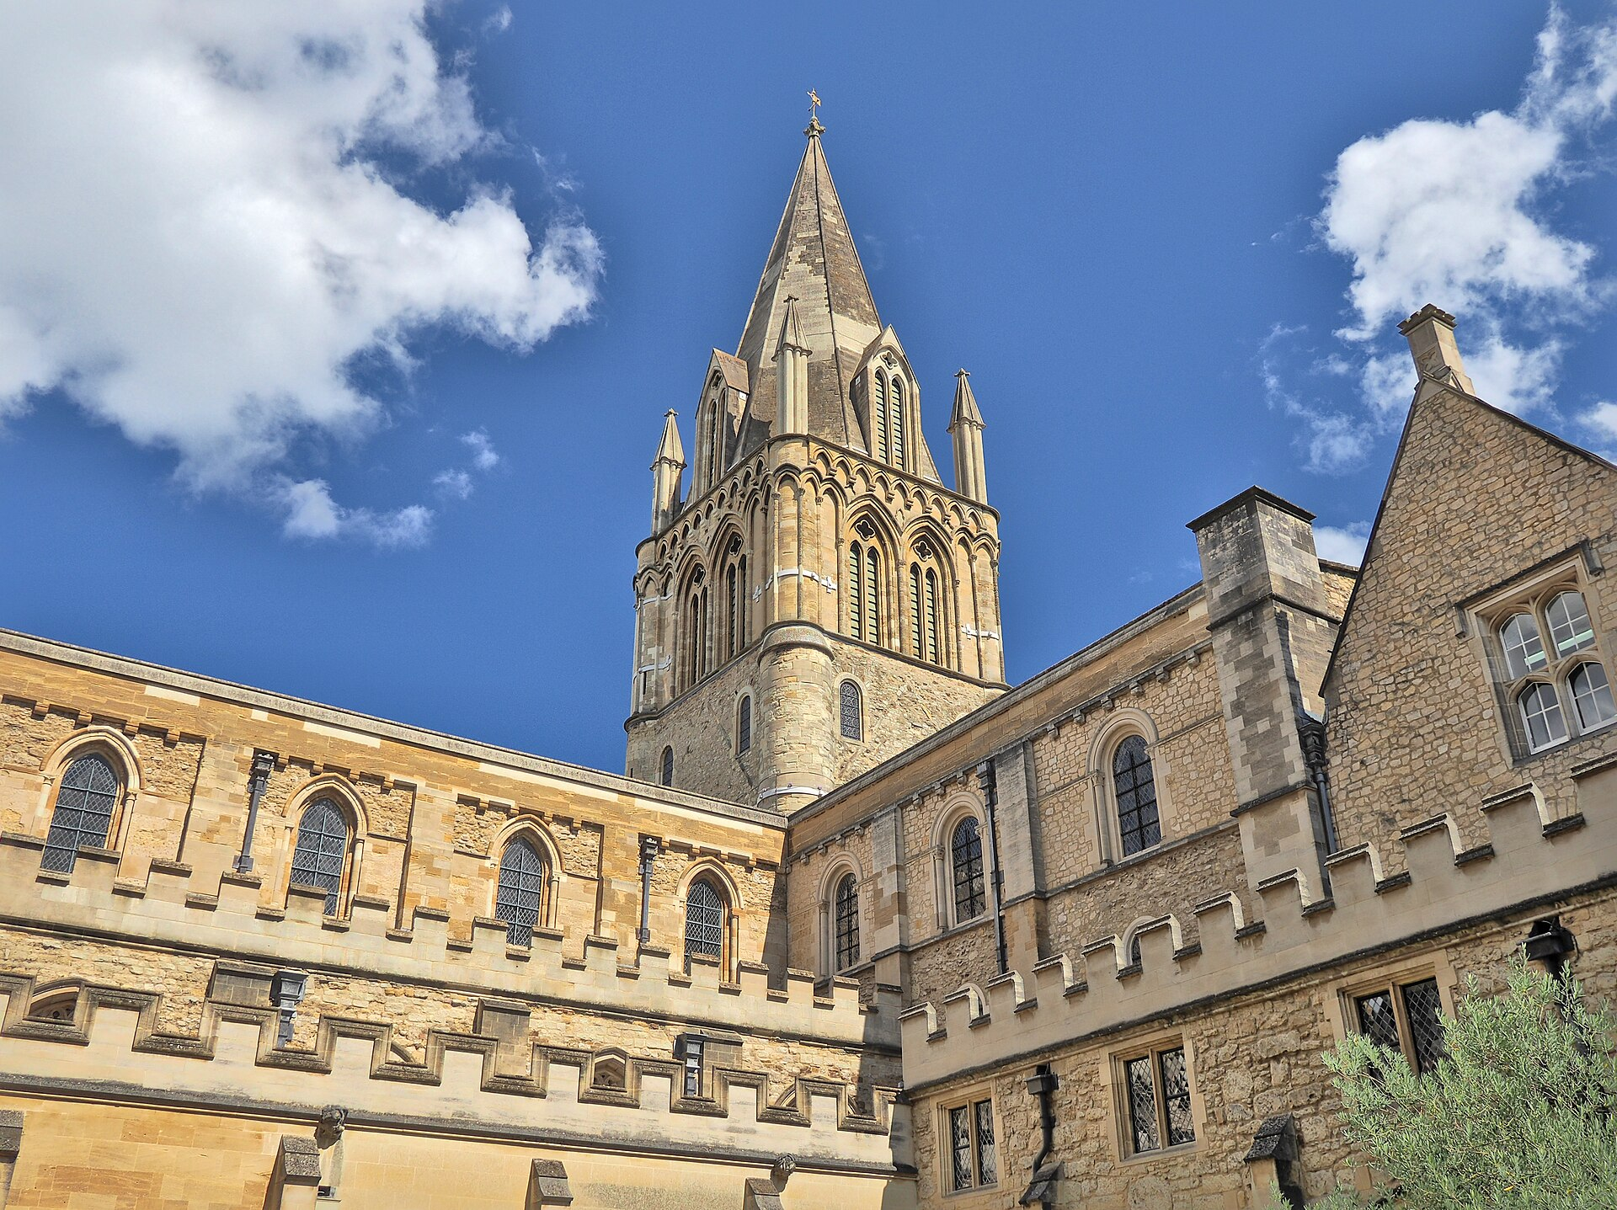
St Frideswide Abbess
In Oxford she founded and was Abbess of a nunnery
A missionary community of catechesis and teaching
Provided for the poor and sick
She remained there until her death

Slide 6
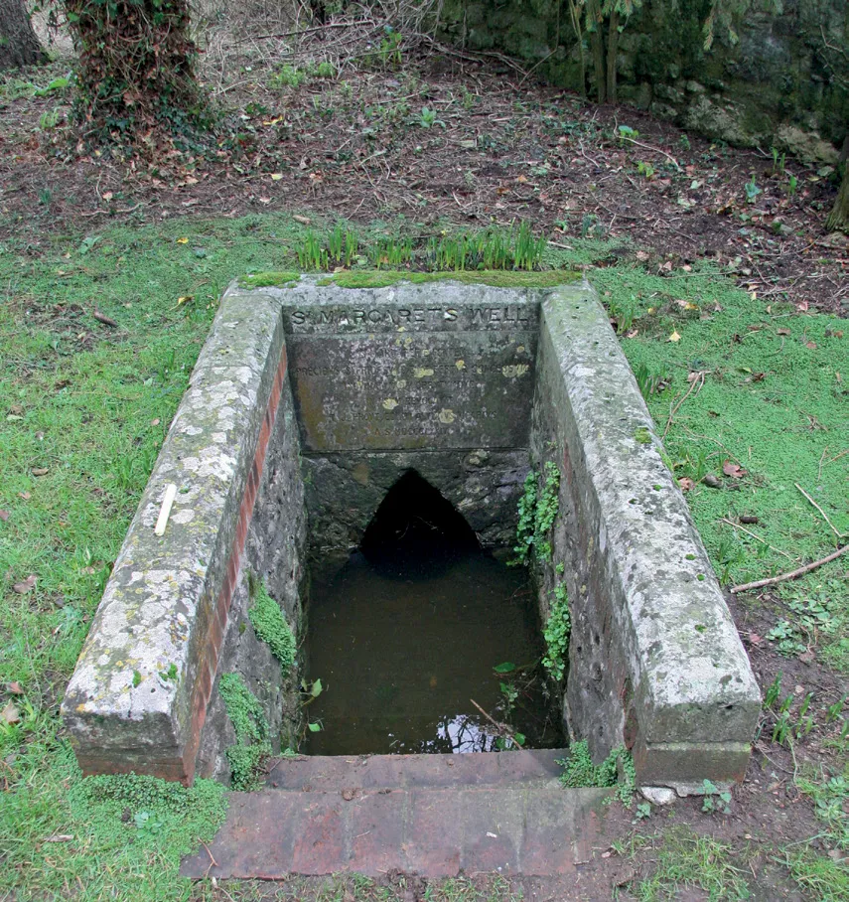
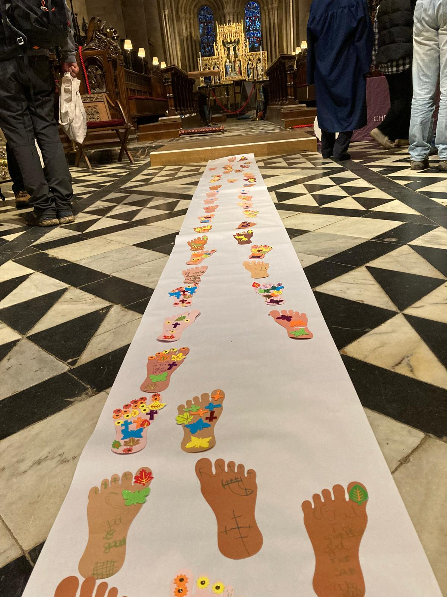
St Frideswide Pilgrimage
Annual diocesan pilgrimage to the well at St Margaret’s, Binsey and her shrine
Her life embraced:
fear in the flight
waiting for her calling as a nun
maintaining the routine of daily service as Abbess

Slide 7
Questions
How do we discern what we are called to be or to do?
How do we trust and wait if answers to prayer are a long time coming, or not what we expect?

Slide 8
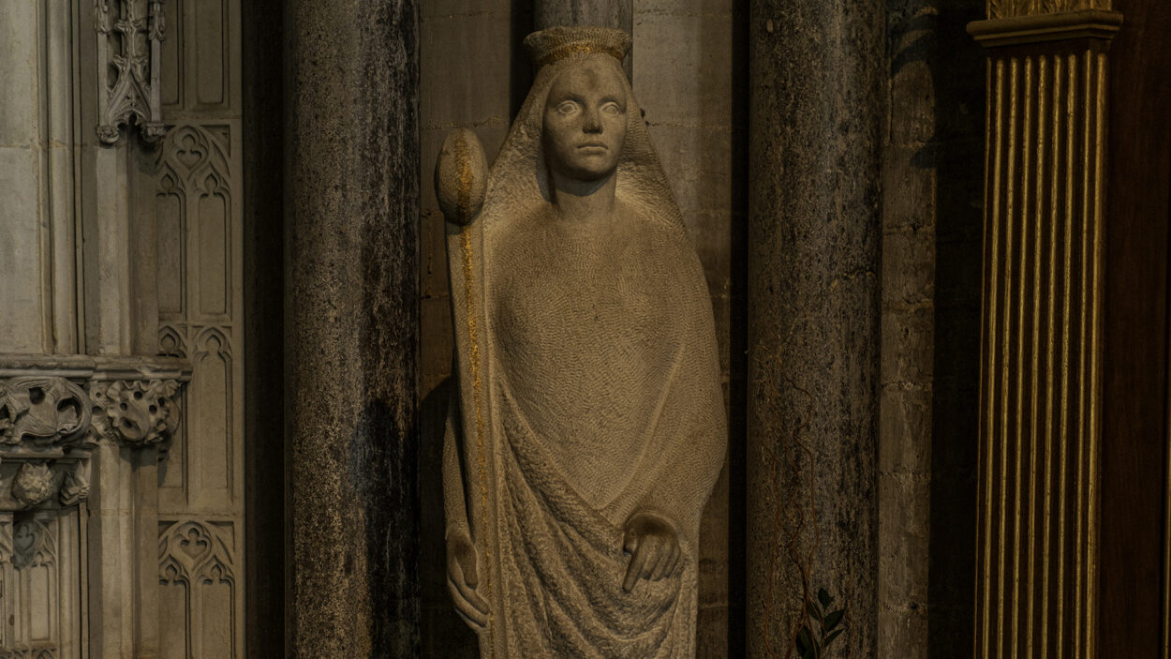
St Etheldreda
Reading: Romans 12.9-18
Patron Saint of Ely
639-679
Earliest account from Bede, “the virgin mother of many virgins”
Daughter of King Anna of East Anglia, devout Christian family
Princess, wife, queen and nun in her time

Slide 9
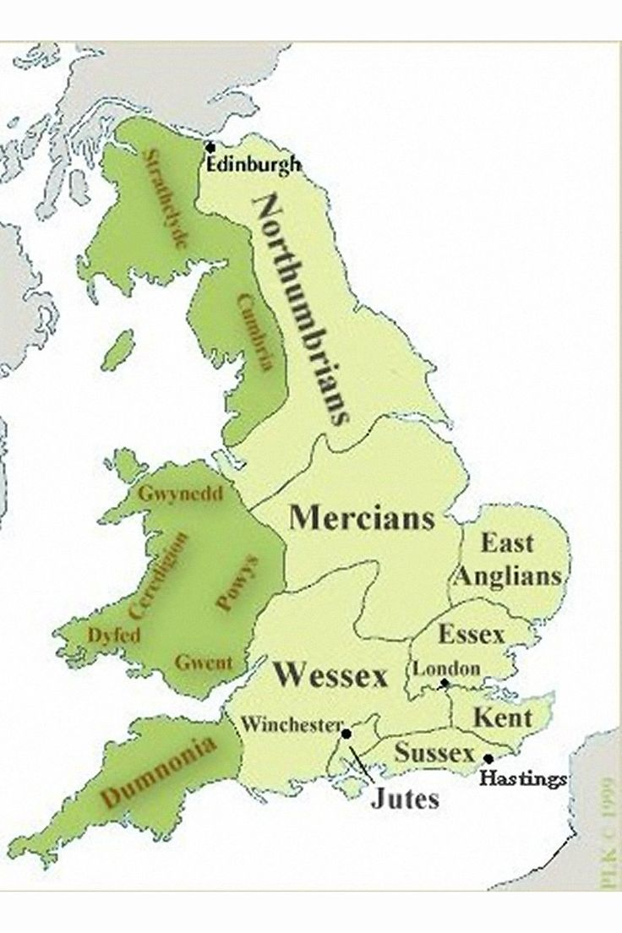
St Etheldreda - marriages
She married twice, both political
Bede: she maintained vows of perpetual virginity through both marriages – a sign of Christian devotion
Retired to Isle of Ely after her first husband’s death 655
Married 660 to Ecgfrith who became King of Northumbria
After 12 years, he tried to ‘claim full marital rights’
Etheldreda, advised and aided by Wilfred, bishop of Northumbria, refused

Slide 10
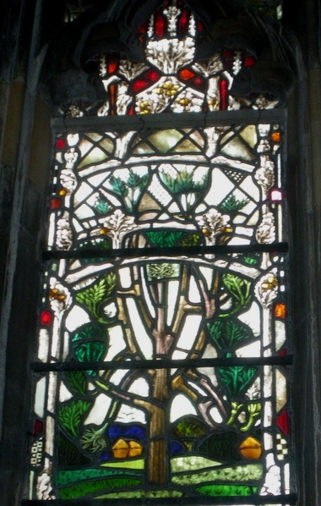
St Etheldreda - flight
Etheldreda decided to become a nun, fled from Northumbria
In 672 she took the veil in Coldingham, Scotland
She fled again, returning to Ely
Legend – she sheltered under an ash tree at Stow which grew from her staff, planted in the ground

Slide 11
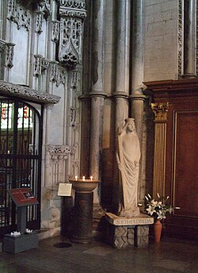
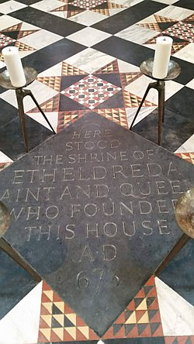
St Etheldreda - Abbess
She sheltered in the ruins of an old church where she founded a double monastery in 673,
The community cared for the sick, offered hospitality
She continued her work through sickness, staying focused, joyful and thankful
Her bones were taken to Ely – her body and clothes were said to hold miraculous powers.

Slide 12
Questions
How do we experience God’s presence or absence in the everyday?
What daily routines do we find helpful in seeking God’s presence, and staying thankful in the dark times?

