Slide 1
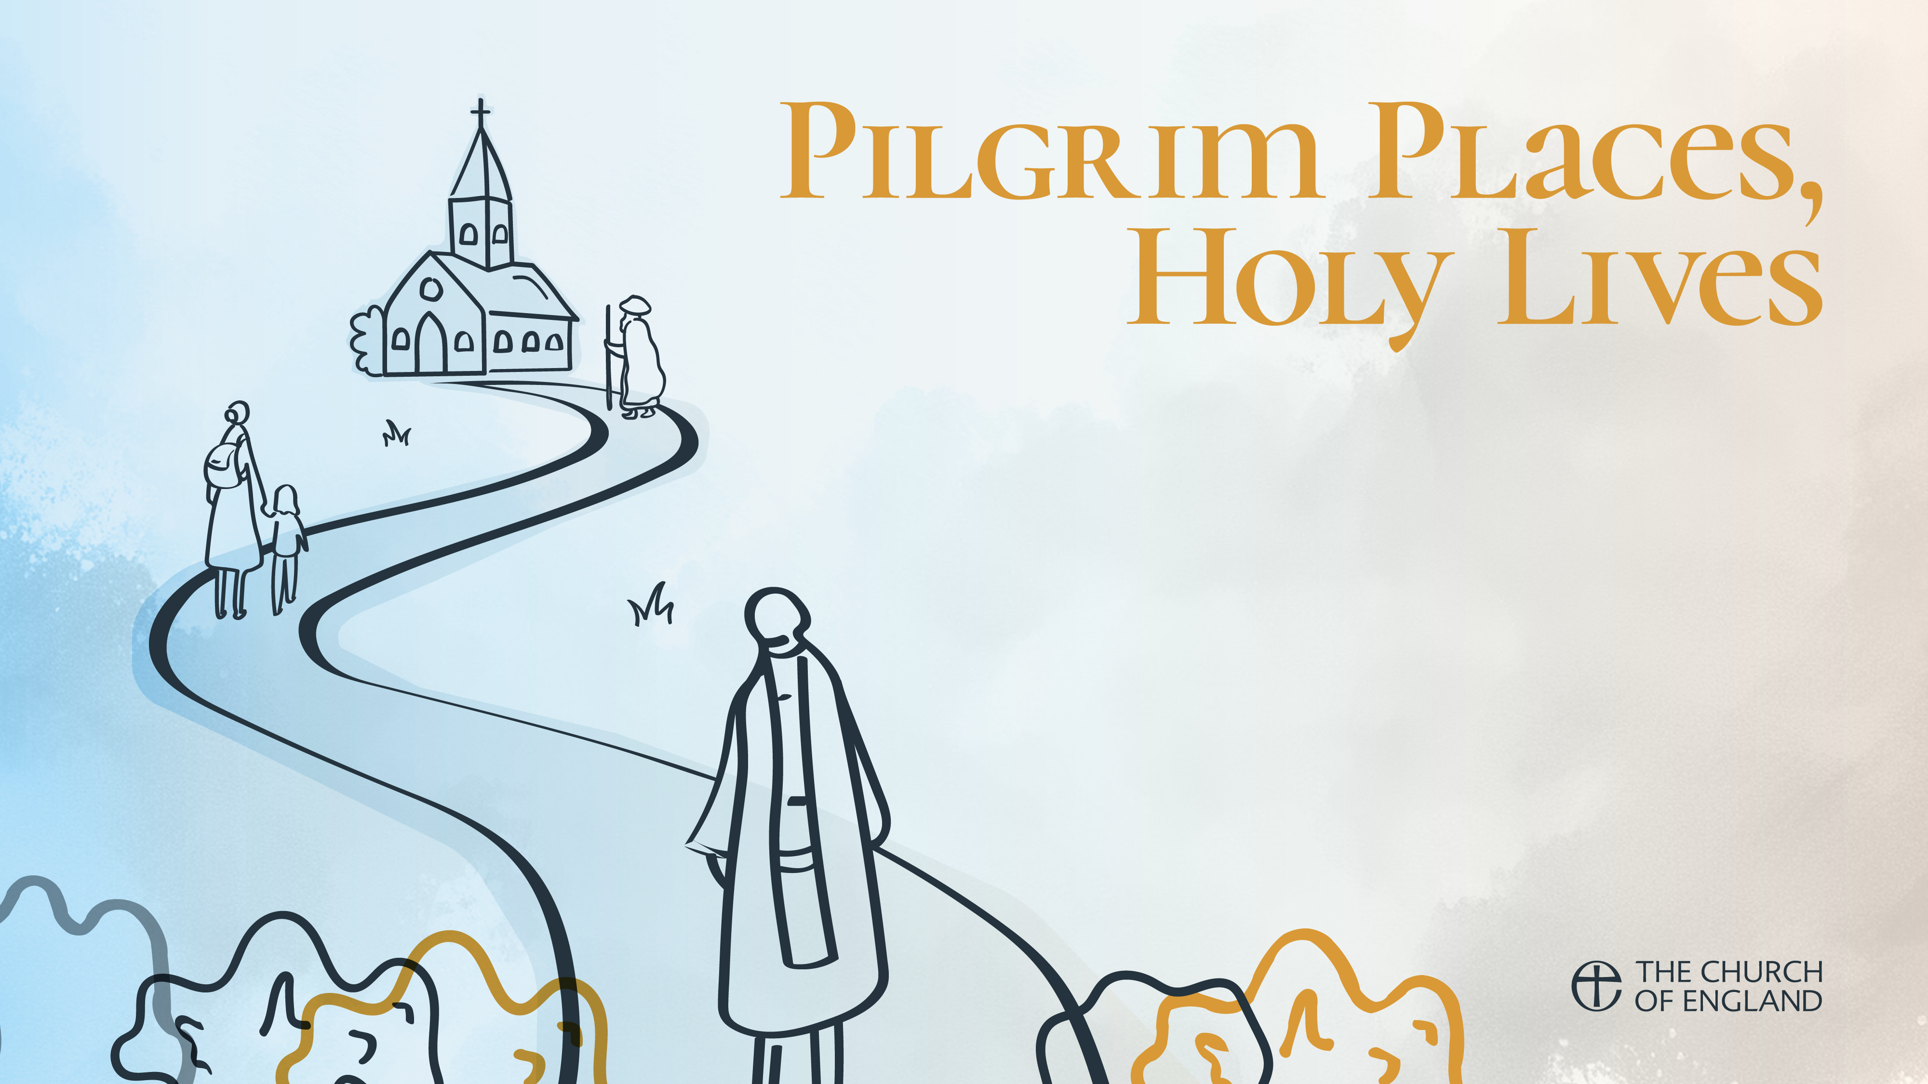
Week 3 St Cedd of Lastingham and St Cuthbert of Lindisfarne
How the Gospel was taken out to the people of Anglo-Saxon England
Journeying in faith, sharing the Good News
Serving God and His people with humility and courage
Learning to give up status and power and to be alone with God

Slide 2
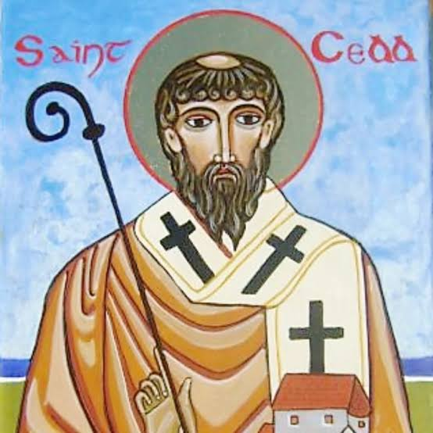
St Cedd of Lastingham
620-664
Brought up on Lindisfarne by Aidan
Sent in 653 to Mercia to evangelise the Middle-Saxons of the Trent Valley
Evangelised the East Saxons in the 650s
Second Bishop of London
Abbot of Lastingham in the North York Moors
Important role at the Synod of Whitby 664
Died at Lastingham of plague in 664

Slide 3
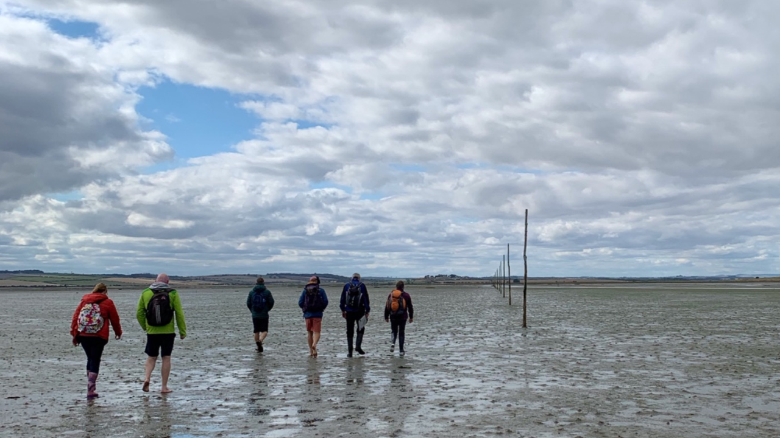
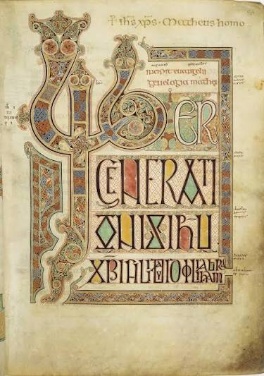
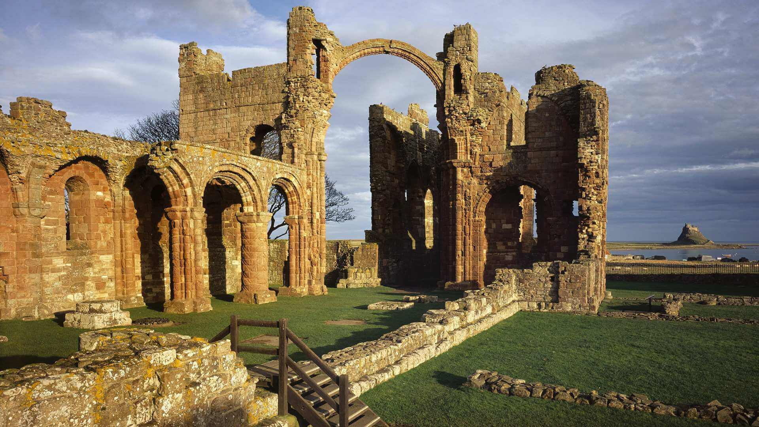
St Cedd – Educated At Lindisfarne
Reading – John 15:4-5
Lindisfarne Abbey founded by Aidan of Iona in 634. Celtic Christianity.
A centre for the re-evangelising of Northern England.
A place of pilgrimage to this day.
A powerhouse of Christian faith, learning and art, such as the Lindisfarne Gospels.
Cedd, one of three brothers, all monks and priests.
Brought up on Lindisfarne, receiving grounding in piety, asceticism and missionary zeal.

Slide 4
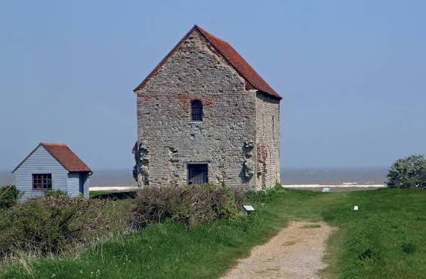
St Cedd – Bringing the gospel to Essex
In 653, abortive mission to the Middle Saxons in Mercia
In 654, sent by Finan of Lindisfarne at the request of Sigebehrt, King of the East Saxons
Successful in mission to the East Saxons
Became Bishop of the East Saxons, including London
Founded many churches, including St Cedd’s Chapel at Bradwell, still a place of pilgrimage.
The patron saint of Essex.

Slide 5
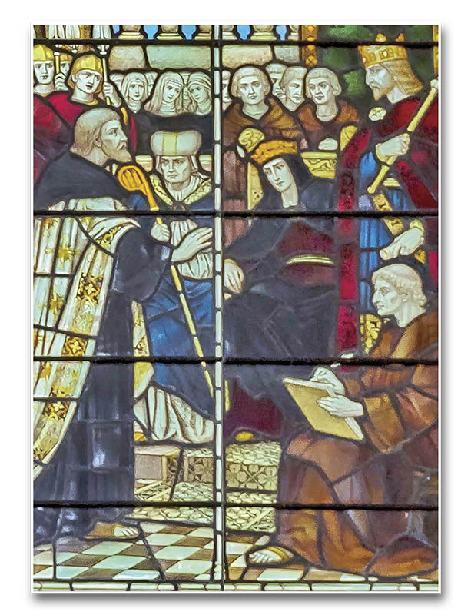
St Cedd – At the Synod of Whitby
Reading – Revelation 7:9-10
The Synod of Whitby was a pivotal. Christian gathering in 664 at Whitby Abbey.
Convened by King Oswiu, the synod settled bitter divisions by ruling that the Anglo-Saxon church would adopt the Roman methods for calculating the date of Easter and observing monastic tonsure, aligning England with the Roman Catholic church and the papacy.
Cedd acted as one of the translators at the Synod. A mediator between the two sides
The Celtic Church lost the argument. Cedd and Cuthbert accepted the decision

Slide 6
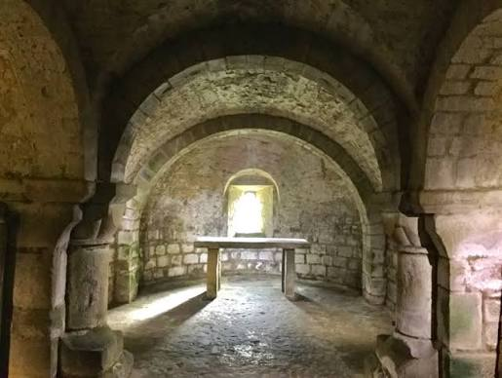
St Cedd – Full Circle at Lastingham
Reading – Luke 5: 10b-11
Lastingham, in the North York Moors
St. Cedd chose the remote, rolling hills of Lastingham in North Yorkshire for his monastery in AD 654. According to the Venerable Bede, he selected this isolated spot among the "high remote hills" because it better resembled a harsh wilderness suited for robbers and wild beasts rather than human habitation
The first church at Lastingham was a monastery founded by St Cedd in 654, where he died and was buried in 664. His brother St Chad succeeded him as abbot…

Slide 7
Questions
Where might God be calling you to step out in faith ?
What are you being asked to leave behind ?
Why not try to listen to someone whose perspectives are different from your own ?
How can you share your faith with someone else ?

Slide 8
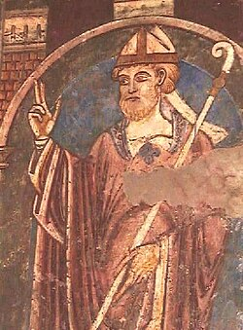
St Cuthbert
634-687
A man of asceticism, charm and generosity, revered in the North-East
In 651, saw a vision of Aidan being carried to Heaven. Joined the Abbey at Melrose
Travelled throughout the North, preaching and ministering to the people
In 664 became Prior of Lindisfarne and implemented the decision of the Synod of Whitby
Retired in 676, drawn to a contemplative life on Inner Farne
Became Bishop of Lindisfarne in 685
Returned to Inner Farne, where he died in 687.
Buried in Durham Cathedral
The patron saint of Northumbria
Written about extensively by Bede

Slide 9
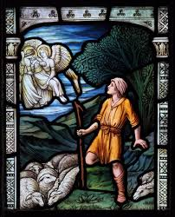
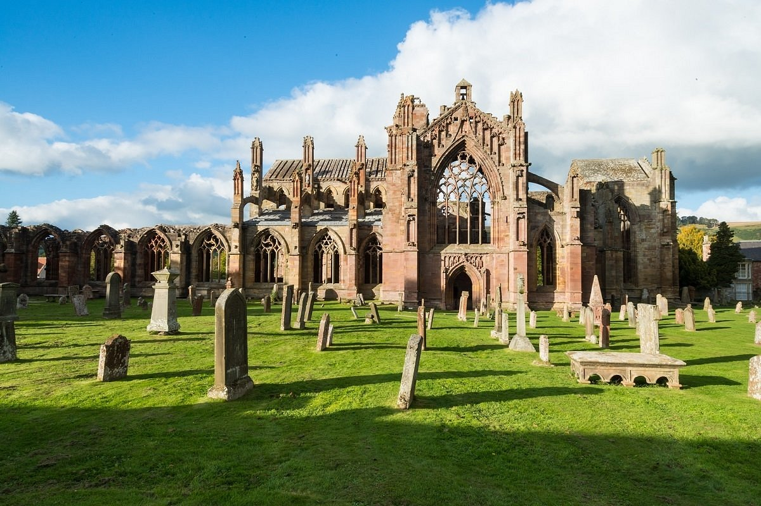
St Cuthbert – Began at Melrose
Tending sheep in Lammermuir Hills,, he saw a vision of Aidan being carried up to Heaven
Went to Melrose Abbey, offering himself for the religious life
Sent to new monastery at Ripon but returned to Melrose
In 661, became Prior of Melrose

Slide 10
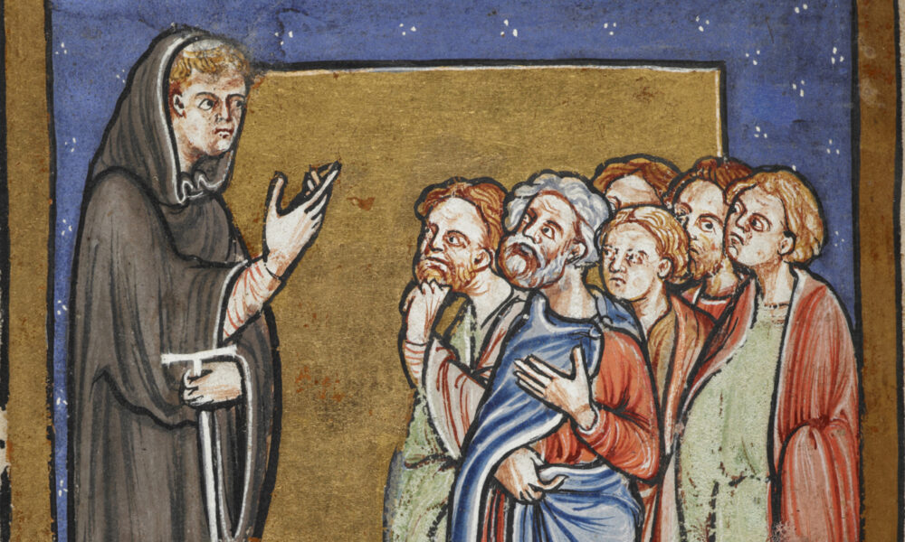
St Cuthbert – A great Preacher & Minister
Reading - 1 Corinthians 3:8-11
Travelled widely across the North as a preacher and missionary
“Cuthbert made a point of searching out those steep rugged places in the hills which other preachers dreaded to visit because of their poverty. This, to him, was a labour of love.”
“Cuthbert had great numbers of people coming to him…They confessed their sins, confided in him about their temptations, and laid open to him the common troubles of humanity … in the hope of gaining comfort… No one left unconsoled”
Bede – The Life of Cuthbert

Slide 11
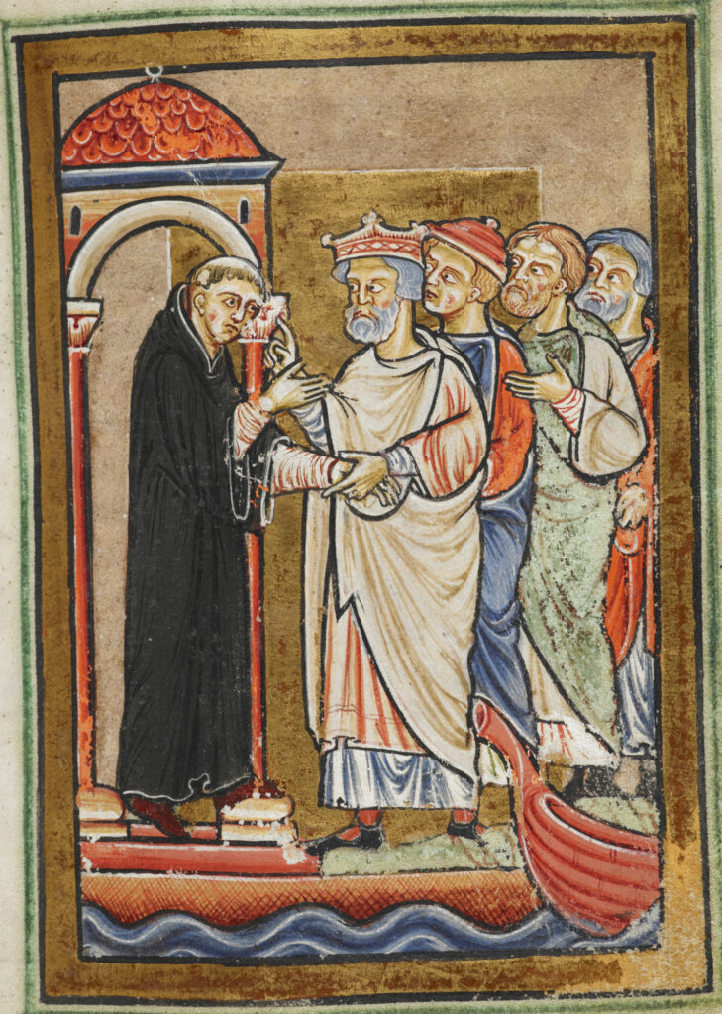
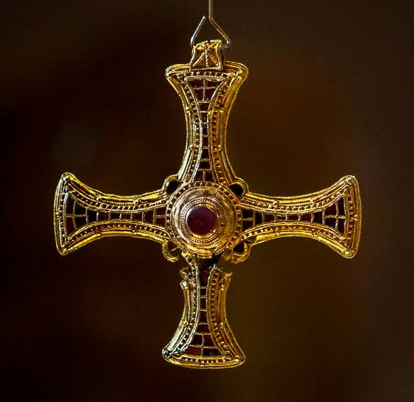
St Cuthbert – A Reluctant leader
Reading – 1 Samuel 16:6-13
Cuthbert moved to Lindisfarne and became Prior. He accepted and implemented the decision made at Whitby,
At this time, he began to withdraw for periods first to St Cuthbert’s Isle, and then to Farne, to focus on God and pray for the world.
People came to share their needs, and he increasingly found himself consulted on royal and monastic affairs beyond his own community. In 685 the king insisted that Cuthbert become a bishop, and he reluctantly agreed.

Slide 12
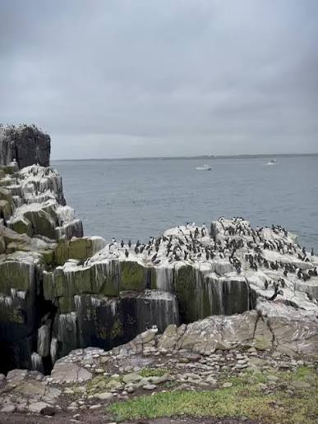
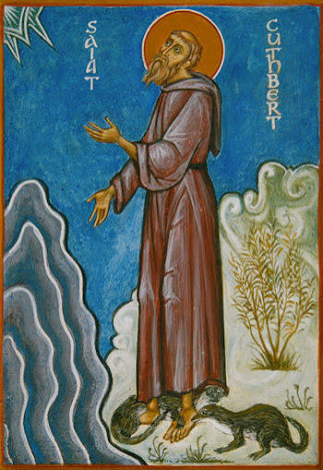
St Cuthbert – Solitary & Contemplative
Reading – Ephesians 3:16-19.
Two years later, he withdrew contentedly to Farne where he died.
He loved being in Nature, which he saw as the work of God.
The story of the otters.

Slide 13
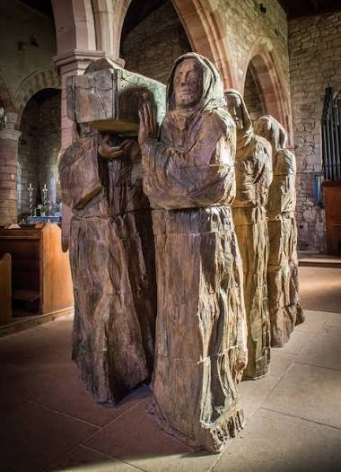
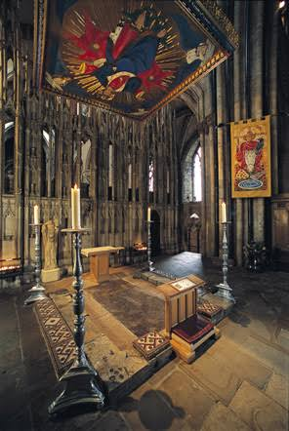
St Cuthbert – Loved and revered
His body was buried at Lindisfarne
After repeated Viking attacks, Lindisfarne was abandoned in 875
The monks carried Cuthbert’s remains in their extended wanderings around the North of England.
Shrine behind the High Altar of Durham Cathedral
His relics remain in place, a focus of pilgrimage, prayer and local pride

Slide 14
Questions
Jesus invites you to follow Him and become a co-builder of the Kingdom of Heaven. How might that look to you today ?
How can you look beyond appearances and see into the heart, as God does ?
Cuthbert had a vision, What is yours ?
Could you give up worldly comfort and be solitary and alone with God and Nature, as Cuthbert did ?
How would you like to be remembered ?

